Slide 1
Decomposition.
Equivalence Partitioning. Boundary Values.
Website: Agoda. Search for apartments
Decomposition of the apartments search function: Link

Slide 2
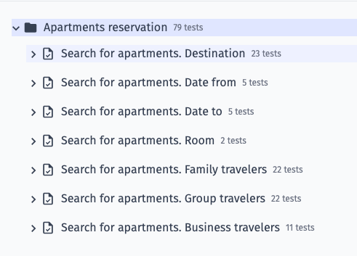
Search for apartments.
Decomposition

Slide 3

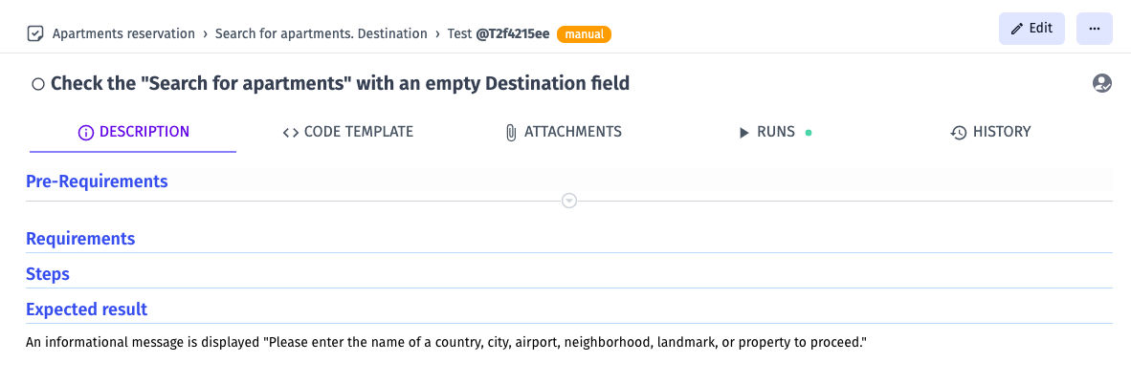

Search for apartments.
Destination.
Checklist using test design techniques- Equivalence Partitioning and Boundary Values

Slide 4



Search for apartments.
Destination.

Slide 5



Search for apartments.
Destination.

Slide 6
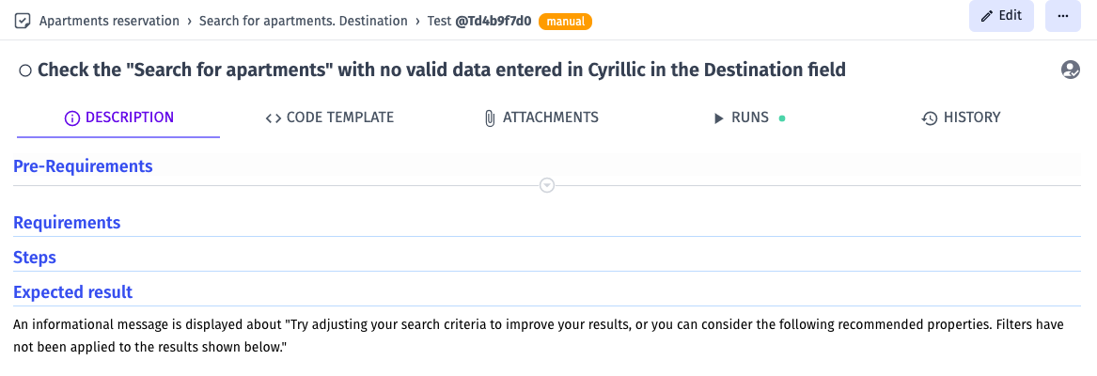


Search for apartments.
Destination.

Slide 7

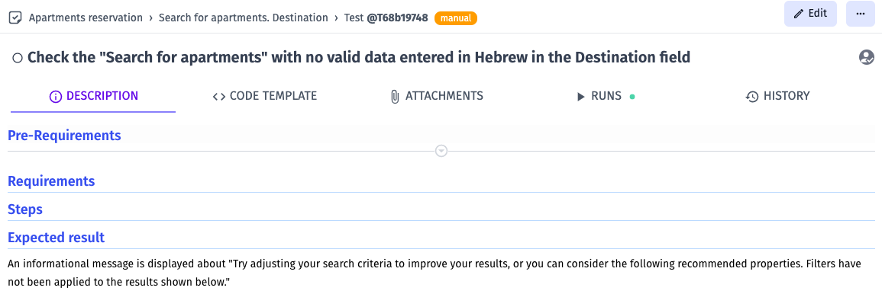

Search for apartments.
Destination.

Slide 8



Search for apartments.
Destination.

Slide 9



Search for apartments.
Destination.

Slide 10


Search for apartments.
Destination.

Slide 11



Search for apartments.
Date from.

Slide 12


Search for apartments.
Date from.

Slide 13



Search for apartments.
Date to.

Slide 14


Search for apartments.
Date to.

Slide 15


Search for apartments.
Room.

Slide 16



Search for apartments.
Room.
Family travelers.
Group travelers.

Slide 17

Search for apartments.
Room.
Family travelers.
Group travelers.

Slide 18



Search for apartments.
Adult.
Family travelers.
Group travelers.

Slide 19


Search for apartments.
Adult.
Family travelers.
Group travelers.

Slide 20



Search for apartments.
Children.
Family travelers.
Group travelers.

Slide 21


Search for apartments.
Children.
Family travelers.
Group travelers.

Slide 22



Search for apartments.
Child's age (years).
Family travelers.
Group travelers.

Slide 23



Search for apartments.
Child's age (years).
Family travelers.
Group travelers.

Slide 24



Search for apartments.
Room.
Business travelers.

Slide 25


Search for apartments.
Room.
Business travelers.

Slide 26



Search for apartments.
Adult.
Business travelers.

Slide 27



Search for apartments.
Adult.
Business travelers.

Slide 28
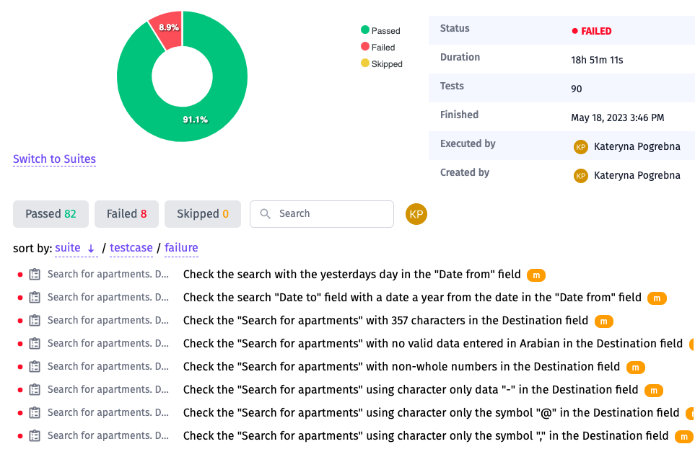
Search for apartments.
Result

